Slide 1
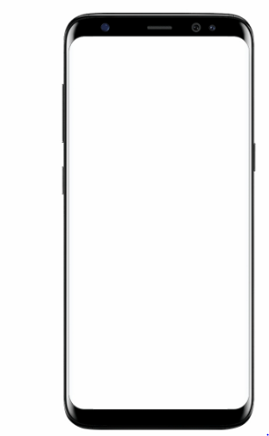

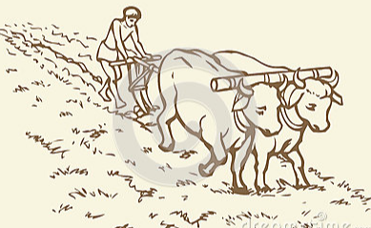
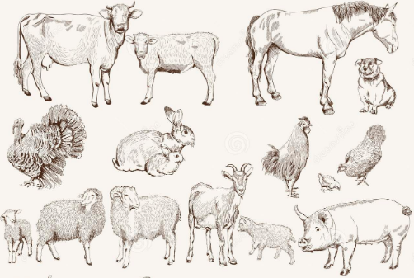
FARM TO HOME
Avoid Mediation
Farmer Products Reaching Directly to the End Users
Providing maximum benefit to the farmer
Example farmer products:
Rice
Doll Items
Turmeric
Vegetables
Pets marketing
Fruits
Procedure: Farmer post a product by using the application then Users get it by approaching the Farmer
AGRICULTURE NEEDS
Providing more flexibility to the farmer
Fulfilling the farmer needs
Seeds
Naaru
Nursery contact info
Daily Labour
Agriculture missionary
Weather Report

Slide 2
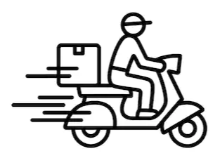
MARKET TO HOME DELIVERY
To fulfilling the Users Needs
Gathering Information about need and taking an Order then Shopping and delivery Done by the delivery person
The delivery Persons are who is Travelling on the same route
And Un employees belongs to the same area
Examples Delivery Works:
Automobile Spare Parts
Agriculture equipment spares
Gressorial
Food parcels
Gift packs
Regular needs
Electrical Needs
Pre planed works ( Sweets, Stretching dresses )
Fuel on Emergency
Chai, Samossa ,Biscuits and Cigarettes
Liquor
Tatkal Tickets and Movie tickets
Mobile Repairing and to the user
And Any type of Works Based on the possibility

Slide 3




HUMAN TRANSPORTATION
Connecting Traveler and User in a same route based on their Preference 2 or 3 or 4-Wheelers
Avoiding Empty Return Trip Planning for all vehicles (2 or 3 or 4-Wheelers and all transport vehicles )
Booking a vehicle or Sharing a vehicle
Booking Private Ambulance while needed

Slide 4

DRIVER JOB
Drivers Registered in App with their Original Driving License Number
Authentications Possibilities
Connecting driver Job vacancy availability info to the Registered Drivers in Application

Slide 5
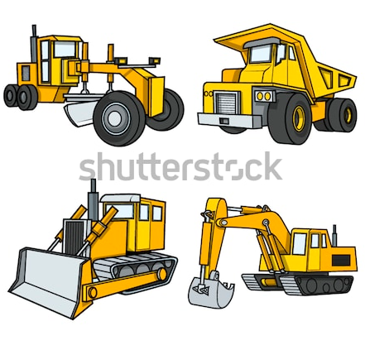
RENTAL EUIPMENT AND EARTH MOVING EQUIPMENT
Connecting work info to the Equipment & missionary owner
Connecting Equipment & missionary info to the needed person
User & Equipment supplier Mutual Communication
Examples:
Road rollers
Cranes
Lorries
Concrete Mixtures
DJ sounds systems
Lighting Equipment
Generators
LCDs&LEDs
Drones
Cameras

Slide 6

SERVICEING AND MAINTANENCE
Electrician
Plumber
Welder
AC Mechanic
Painters
TV Mechanics
Barbers
Bike Mechanics
All types of Construction Workers

Slide 7

SELF MARKETTING

Slide 8


ONE DAY HIRING
Assigning a Work to a person per a day
Example:
Care Taker,
Taking old people to hospital and Functions

Slide 9


FOOD DELIVERY
Providing Delivery from the Required destination
Same Route traveler will fulfill your order needed
NON -VEG
Supply based on the order
Order should be placed before 1-day
(PAYMENT TRANSACTION FACILITY SHOULD BE MANDATE)

Slide 10
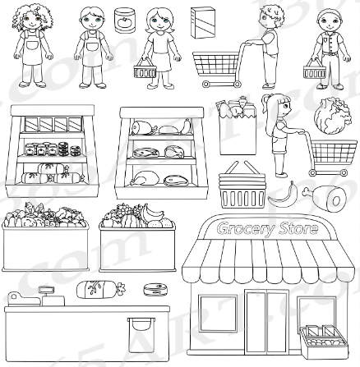

Slide 11

MEDICAL SERVICES
Medicine Delivery
Blood Delivery (Only Delivery Purpose)
Ambulance Contact Info

Slide 12
SECOND HAND SALES
Mobiles
Electronic Gadgets
Missionary
Vehicles
Property

Slide 13


Slide 14
APP REQUIRED FEATURES
Simple User interface provided to communication between user and service person
User Contact Information Must
Work Filtering Based on Pin Code System
Payment System
(Try to avoid payment gate way by using G-pay , Phone-pay , Pay tm ect..)
GPS Tracking System(Route map)
Photo and Message Conversation
Call Connectivity through the application
Works List Based on the Route map
Work Order Status
Work accepted list
Completion Status
Notifications alert
Multi Languages
Rating For Service person by the user
Advertisement facility( Particular Area )
Advertisement facility ( Particular Services )
Ex: agriculture Ads, driver Ads ,food Ads in related fields only.
Feed back

Slide 15
QUESTIONS ABOUT DESIGNING AN APPLICATION
What is the best way to create the trust on app ?
Which is the best and safest methods for login?
How to protect the application from the misusers?
What type of support provided by the developer after launching the application?
Is it necessity to collect user bank account details ?
Which is the best payment method?
Estimated app size?
What are the required permission at the time of installation?
What is the procedure for payment receiving and return?
What are the legal issues for…?
Human Transport
Medical services
Food Delivery
Ads
About data backup?
About cloud?
What type of responsibilities of developer after delivery the application?
What about Updates, Servicing & maintenance?
What about security features?
What are the requirements to placed the Application in play store?

